Slide 1
Deep Reinforcement Learning (DRL) Framework for Reservoir Management
Shubhendu Kumar Singh

Slide 2
Proximal Policy Optimization (PPO) based Reservoir Control (Mean-Std Standardization) (Reward- Target Storage) (Agent with 2 actions:) (First – Q1 Release – cumulative NIIP demand) (Second-Q2 Release-Min Release of 350 cfs for fisheries + Hydropower (Total Release <=5000cfs)
Date:08/14/2025

Slide 3
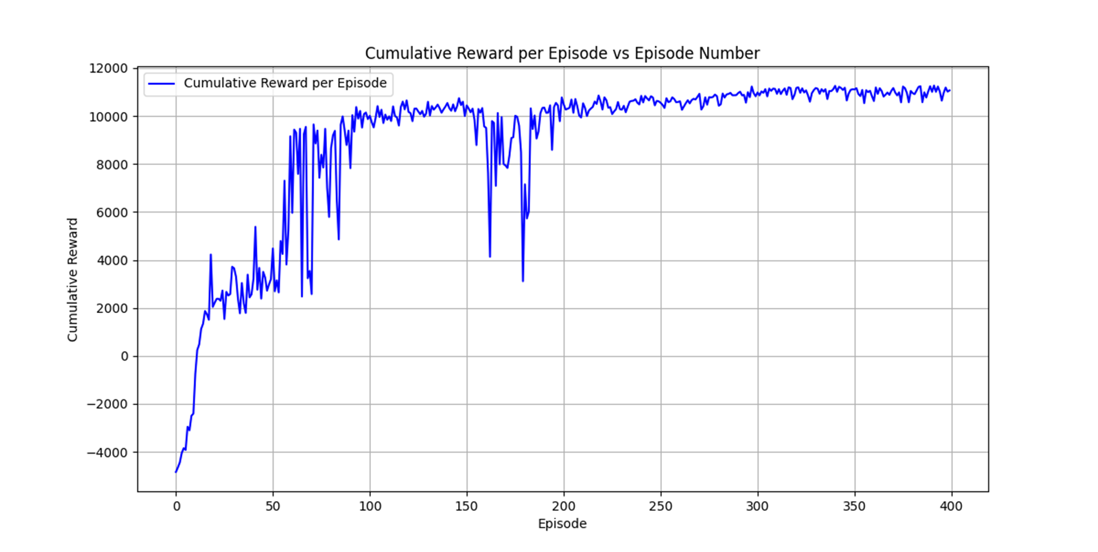
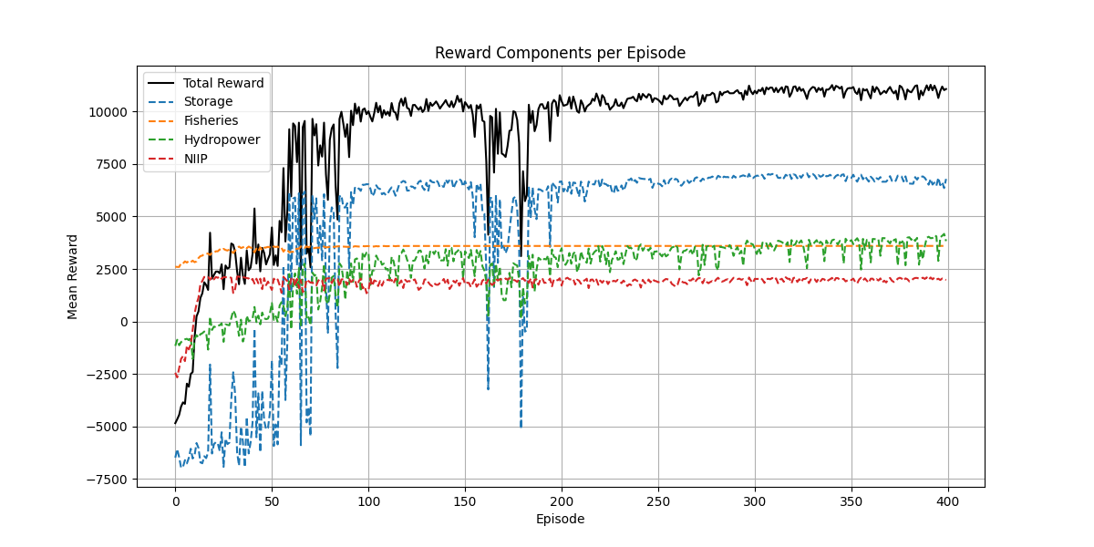
PPO Training : Train Data Size - 18000, Episode Length - 3600 days, Total Episodes – 400, Mean-Std Standardization, Reward: Target Storage, Two separate release-1. Q1 release( cum NIIP demand) , 2. Q2 Release (Fisheries-min 350 cfs + Hydropower (288-768 MWh), Sum of both the release<=5000cfs, Release range –(0 - 5000 cfs) for both the actions

Slide 4
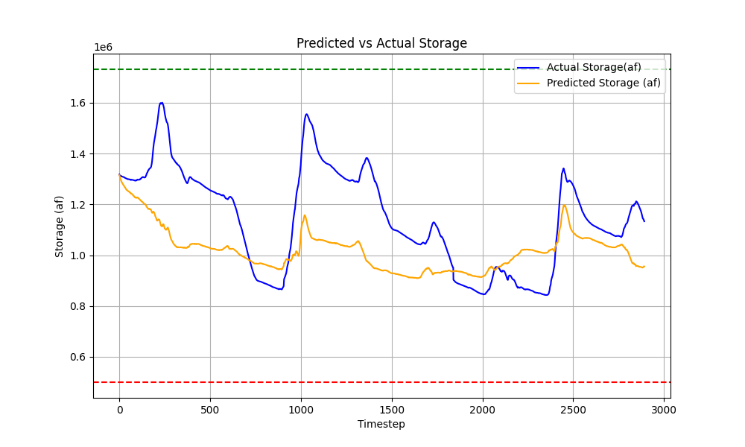
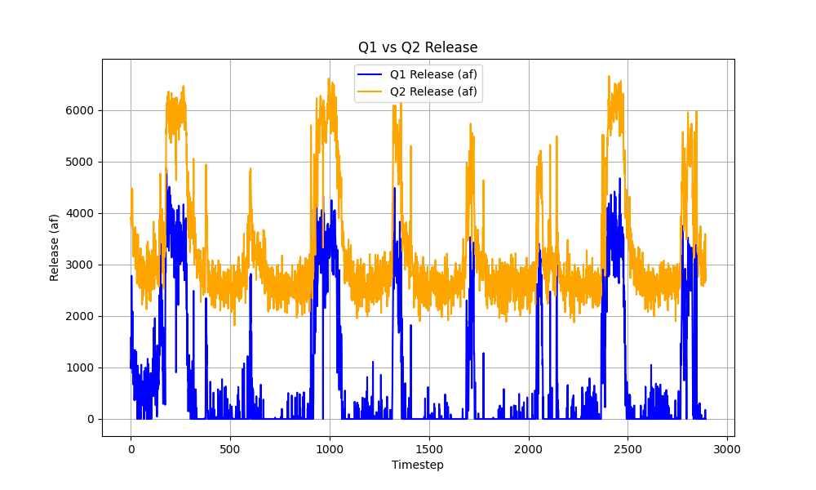
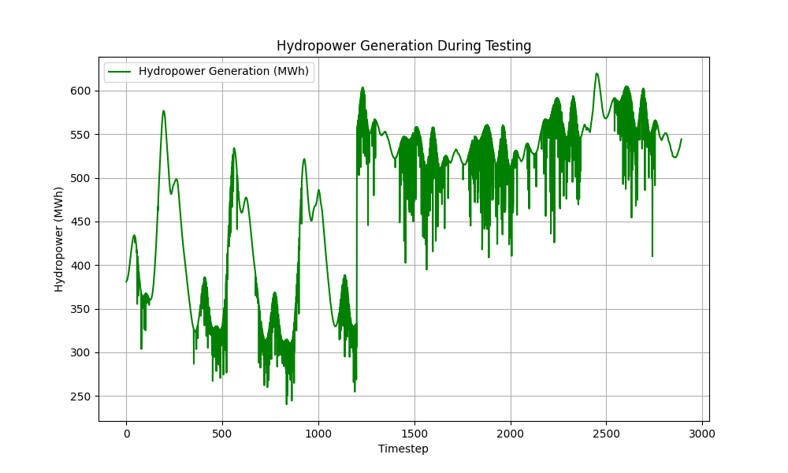
PPO Testing : Test Data Size- 3000 approx.

Slide 5
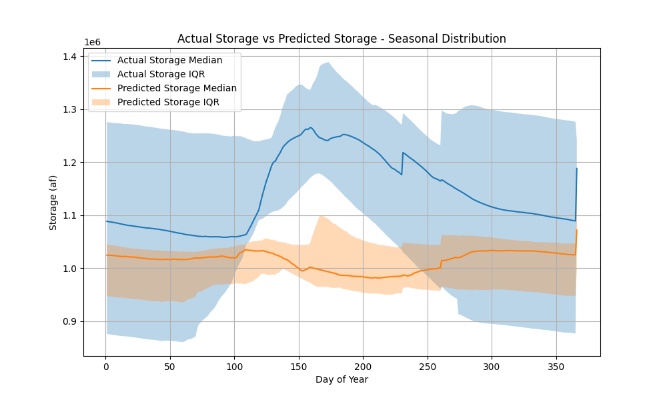
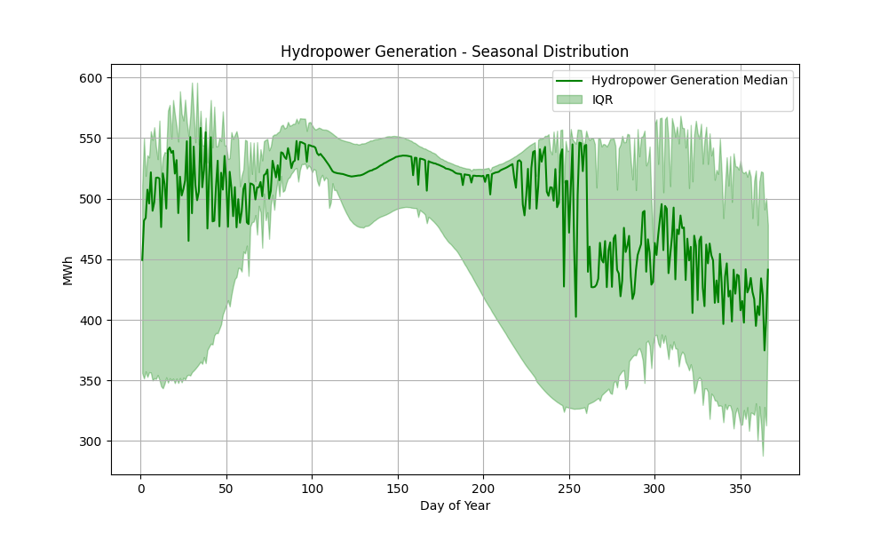
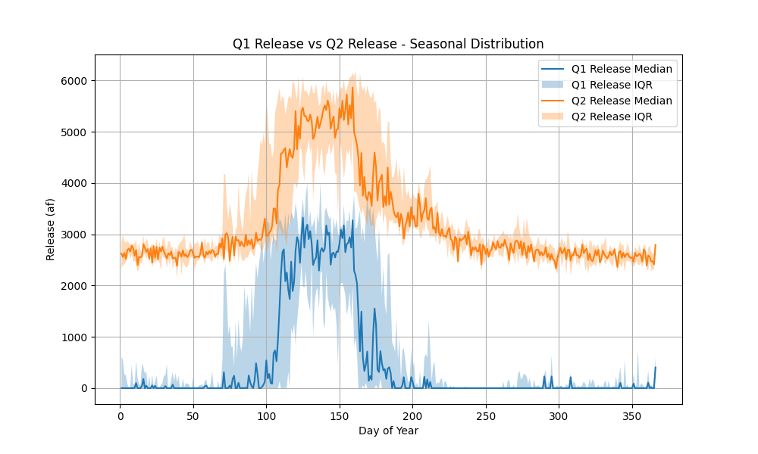
PPO Testing : Test Data Size- 3000 approx.

Slide 6
PPO Testing : Test Data Size- 3000 approx.
Year | Days_with_Demand | Fulfilled_Days | Fulfillment_% | Total_Demand_Volume | Total_Release_Volume | Volume_Fulfillment_%
2017 | 148 | 148 | 100 | 115453.1857 | 424614.5942 | 367.7807516
2018 | 148 | 80 | 54.05405405 | 115453.1857 | 32944.12875 | 28.5346208
2019 | 148 | 148 | 100 | 115453.1857 | 437151.0196 | 378.6392006
2020 | 148 | 148 | 100 | 115453.1857 | 138530.9153 | 119.9888201
2021 | 148 | 112 | 75.67567568 | 115453.1857 | 83183.68248 | 72.04970739
2022 | 148 | 128 | 86.48648649 | 115453.1857 | 88090.56967 | 76.29981721
2023 | 148 | 148 | 100 | 115453.1857 | 381939.9476 | 330.818024
2024 | 128 | 128 | 100 | 87301.86789 | 166054.5516 | 190.2073296

Slide 7
Proximal Policy Optimization (PPO) based Reservoir Control (Mean-Std Standardization) (Reward- Target Storage) (Agent with 2 actions:) (First – Q1 Release – daily NIIP demand) (Second-Q2 Release-Min Release of 350 cfs for fisheries + Hydropower (Total Release <=5000cfs)

Slide 8
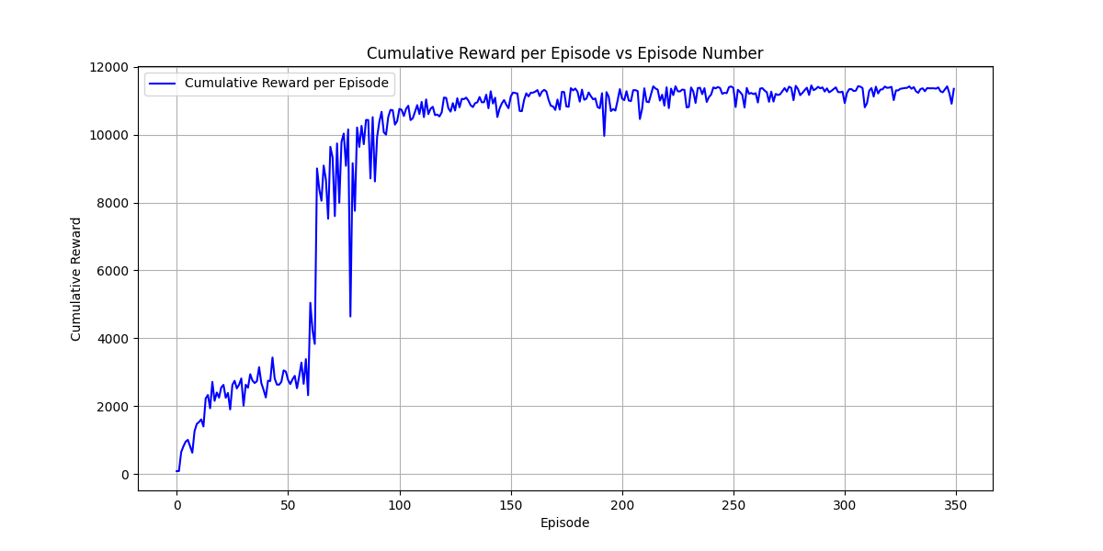
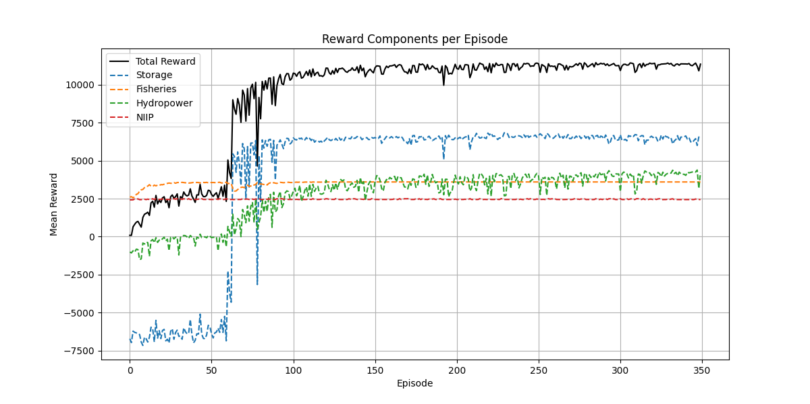
PPO Training : Train Data Size - 18000, Episode Length - 3600 days, Total Episodes – 400, Mean-Std Standardization, Reward: Target Storage, Two separate release-1. Q1 release( daily NIIP demand) , 2. Q2 Release (Fisheries-min 350 cfs + Hydropower (288-768 MWh), Sum of both the release<=5000cfs, Release range –(0 - 5000 cfs) for both the actions

Slide 9
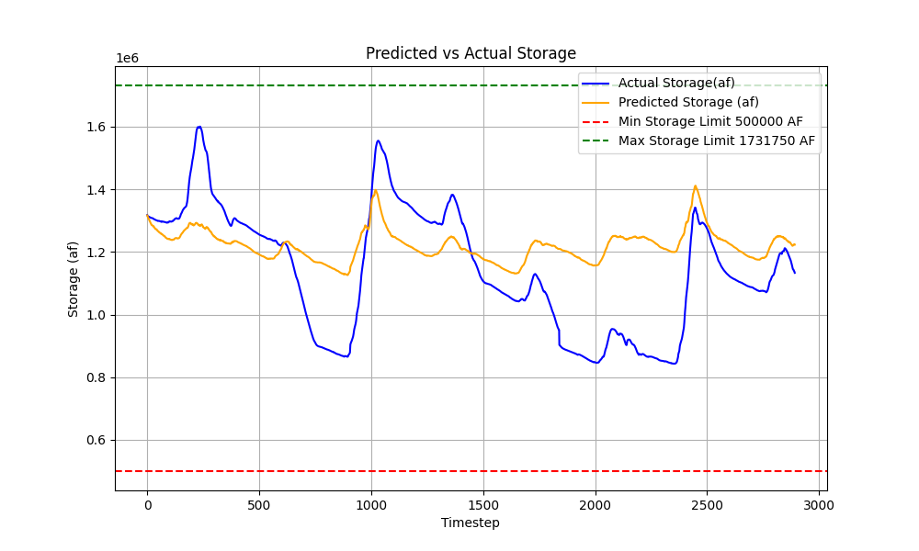
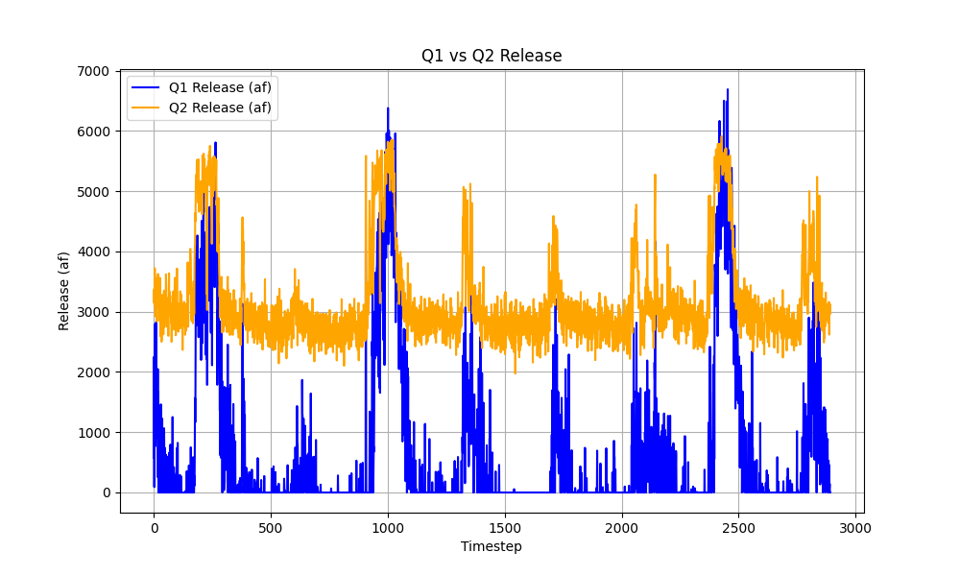
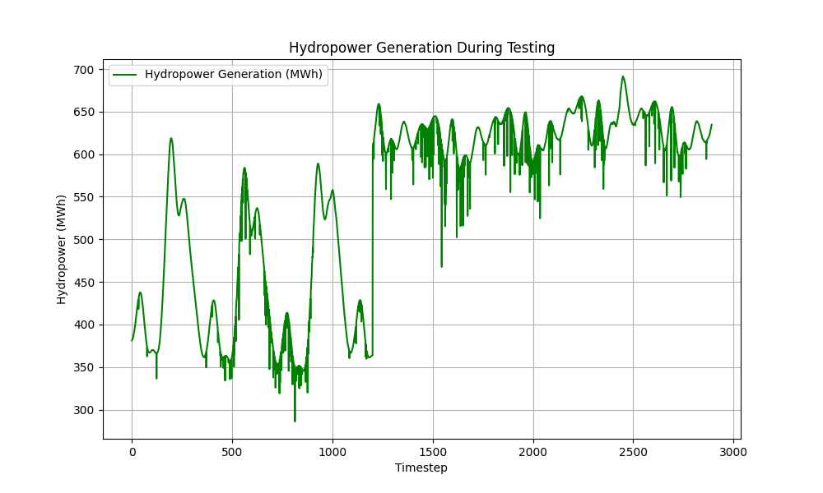
PPO Testing : Test Data Size- 3000 approx.

Slide 10
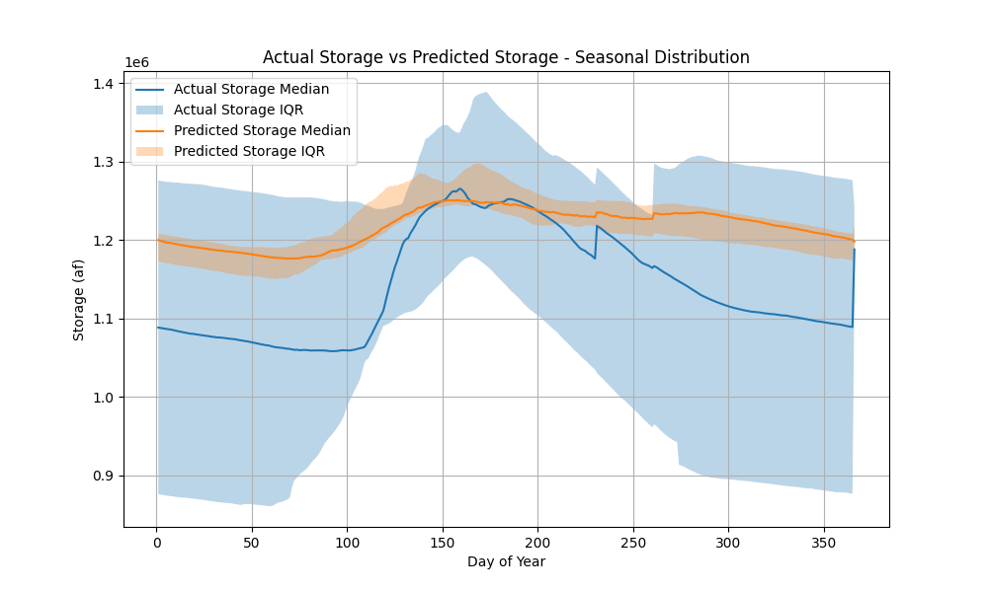
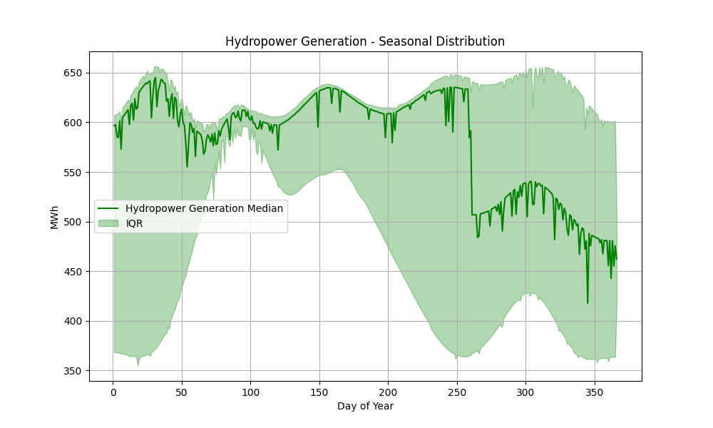
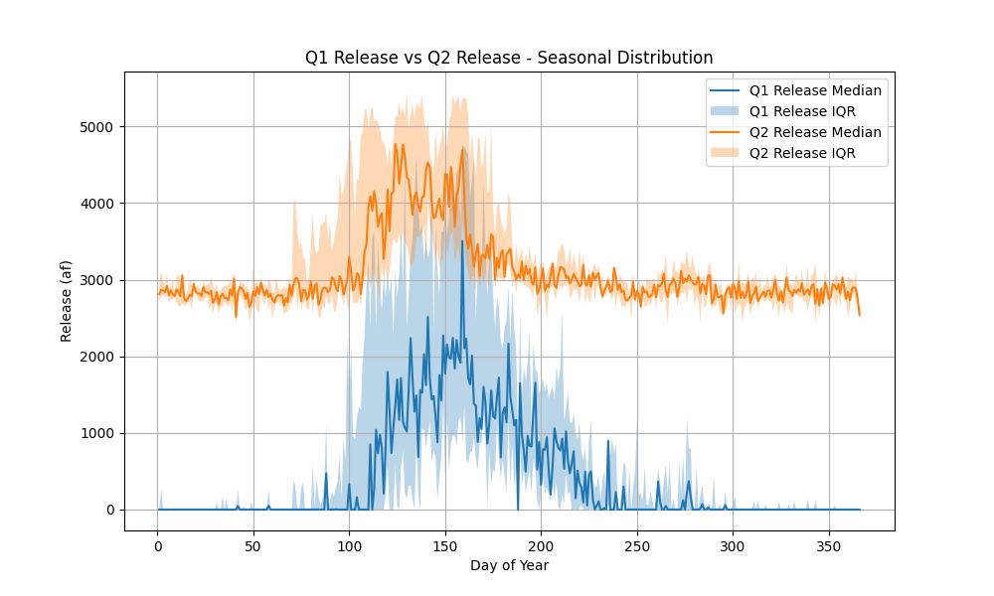
PPO Testing : Test Data Size- 3000 approx.

Slide 11
PPO Testing : Test Data Size- 3000 approx.
Year | Days_with_Demand | Fulfilled_Days | Fulfillment_% | Total_Demand_Volume | Total_Release_Volume | Volume_Fulfillment_%
2017 | 148 | 97 | 65.54054054 | 115453.1857 | 330768.4385 | 286.4957224
2018 | 148 | 19 | 12.83783784 | 115453.1857 | 27637.92721 | 23.93864408
2019 | 148 | 134 | 90.54054054 | 115453.1857 | 502173.2265 | 434.9583109
2020 | 148 | 63 | 42.56756757 | 115453.1857 | 114963.1352 | 99.57554176
2021 | 148 | 36 | 24.32432432 | 115453.1857 | 62533.23277 | 54.16328045
2022 | 148 | 47 | 31.75675676 | 115453.1857 | 87066.76491 | 75.41304674
2023 | 148 | 110 | 74.32432432 | 115453.1857 | 456565.4892 | 395.4550811
2024 | 128 | 69 | 53.90625 | 87301.86789 | 123874.8431 | 141.8925461

Slide 12
Proximal Policy Optimization (PPO) based Reservoir Control (Mean-Std Standardization) (Reward- Target Storage) (Agent with 2 actions:) (First – Q1 Release – cumulative NIIP demand) (Second-Q2 Release-Min Release of 350 cfs for fisheries + Hydropower (Total Release <=5000cfs) – new hydropower model
Date:08/28/2025

Slide 13
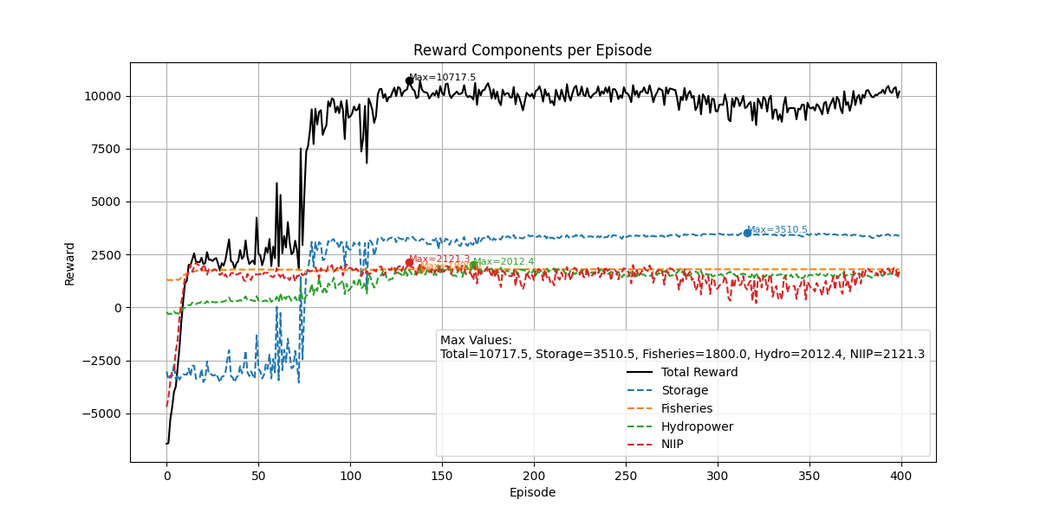
PPO Training : Train Data Size - 18000, Episode Length - 3600 days, Total Episodes – 400, Mean-Std Standardization, Reward: Target Storage, Two separate release-1. Q1 release( cum NIIP demand) , 2. Q2 Release (Fisheries-min 350 cfs + Hydropower (288-768 MWh), Sum of both the release<=5000cfs, Release range –(0 - 5000 cfs) for both the actions

Slide 14
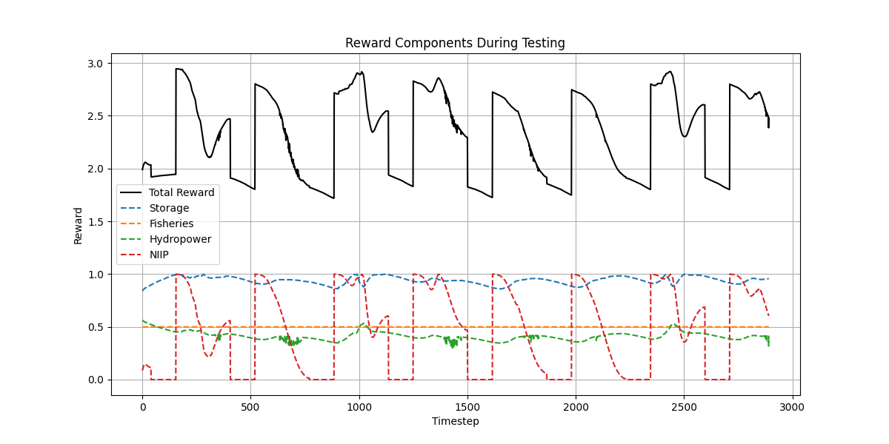
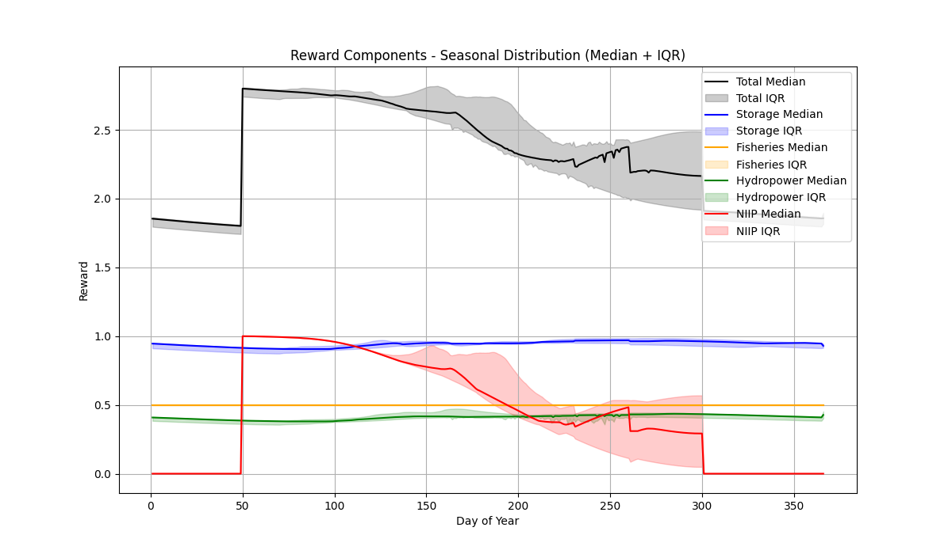
PPO Testing : Test Data Size- 3000 approx.

Slide 15
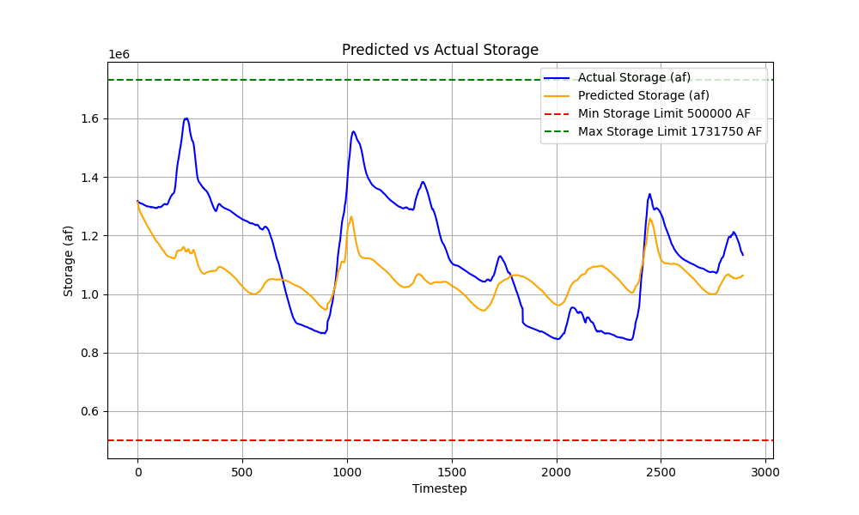
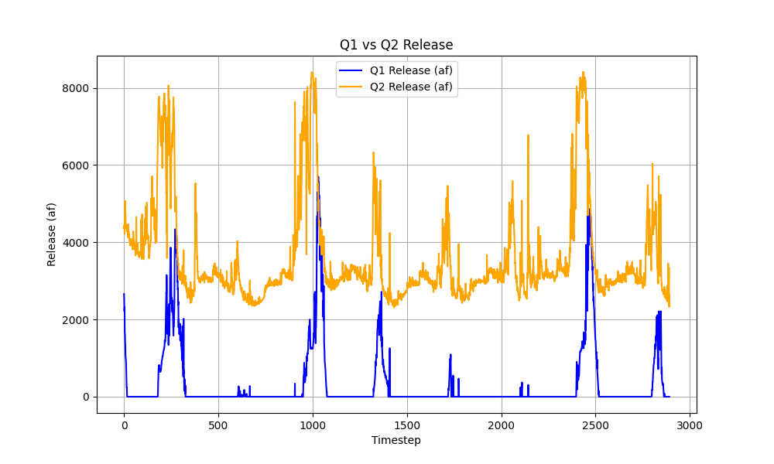
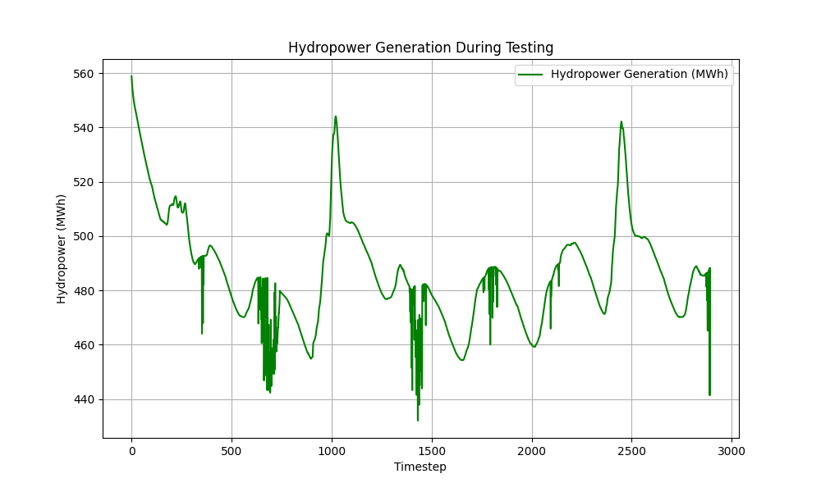
PPO Testing : Test Data Size- 3000 approx.

Slide 16
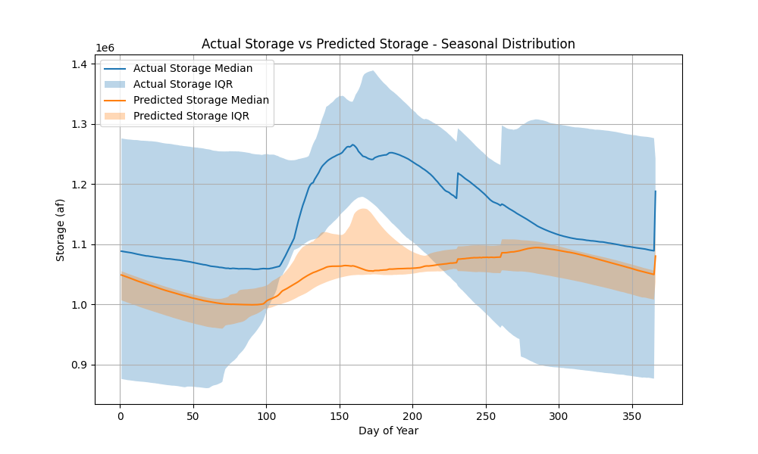
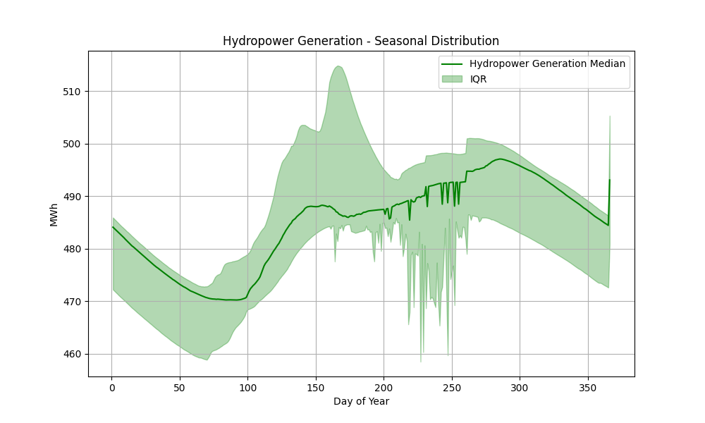
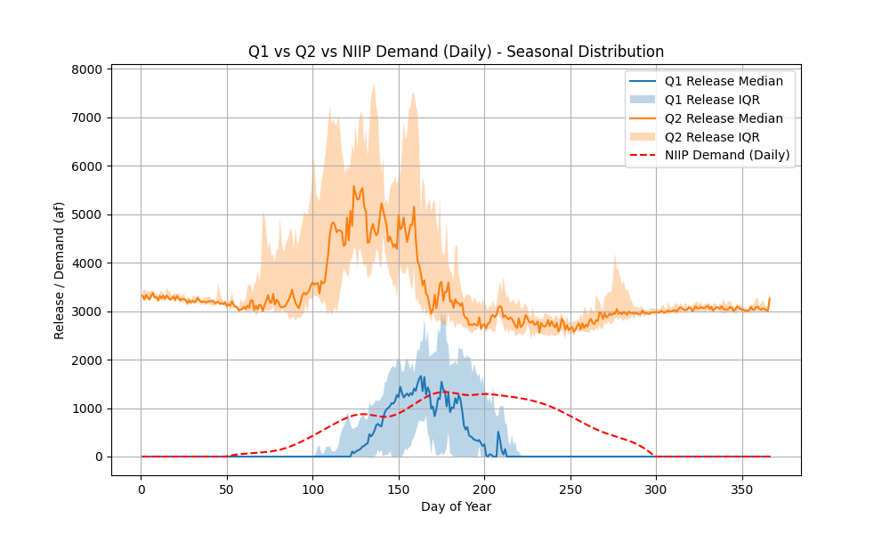
PPO Testing : Test Data Size- 3000 approx.

Slide 17
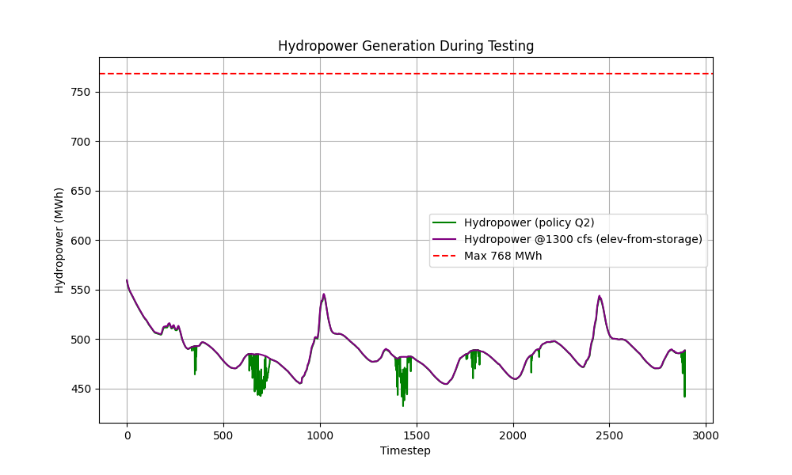
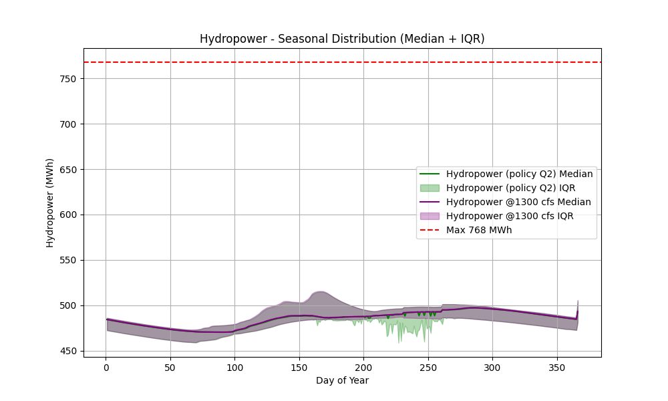
PPO Testing : Test Data Size- 3000 approx.

Slide 18
Proximal Policy Optimization (PPO) based Reservoir Control (Mean-Std Standardization) (Reward- Target Storage) (Agent with 2 actions:) (First – Q1 Release – cumulative NIIP demand) (Second-Q2 Release-Min Release of 350 cfs for fisheries + Hydropower (Total Release <=5000cfs) – previous hydropower model Slightly adjusted NIIP reward weight

Slide 19
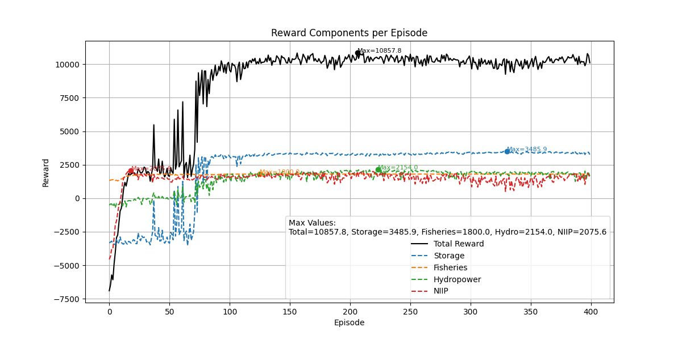
PPO Training : Train Data Size - 18000, Episode Length - 3600 days, Total Episodes – 400, Mean-Std Standardization, Reward: Target Storage, Two separate release-1. Q1 release( cum NIIP demand) , 2. Q2 Release (Fisheries-min 350 cfs + Hydropower (288-768 MWh), Sum of both the release<=5000cfs, Release range –(0 - 5000 cfs) for both the actions

Slide 20
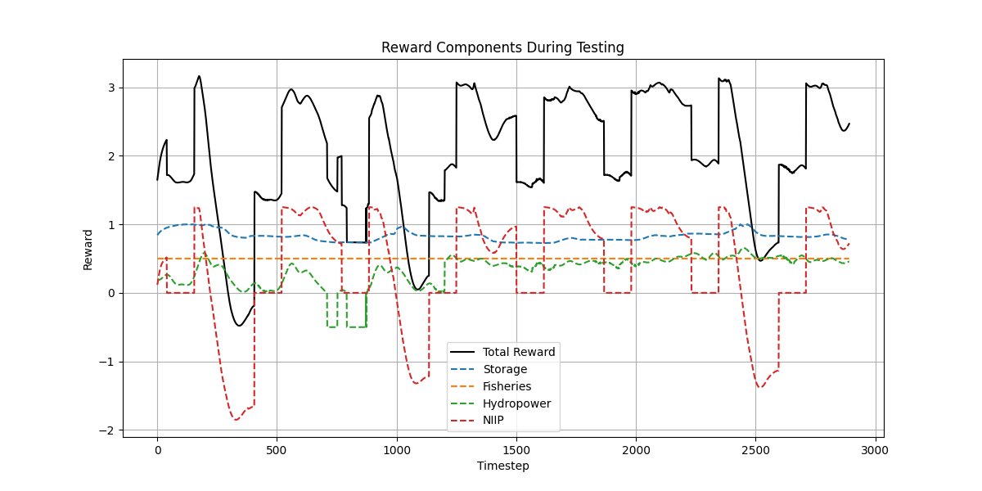
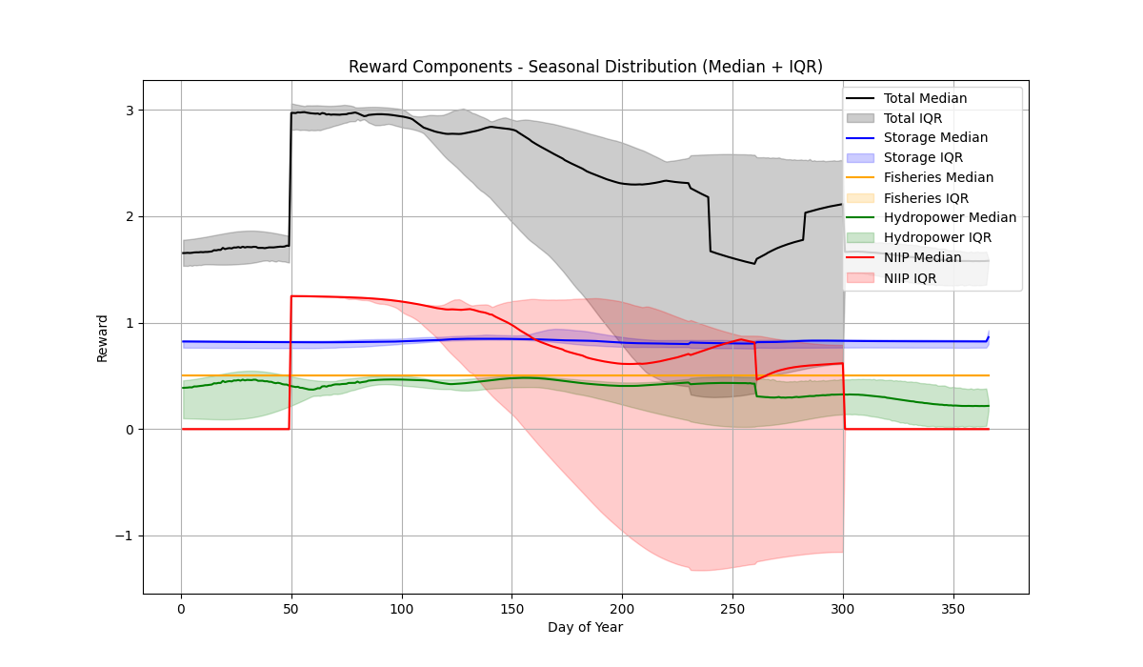
PPO Testing : Test Data Size- 3000 approx.

Slide 21
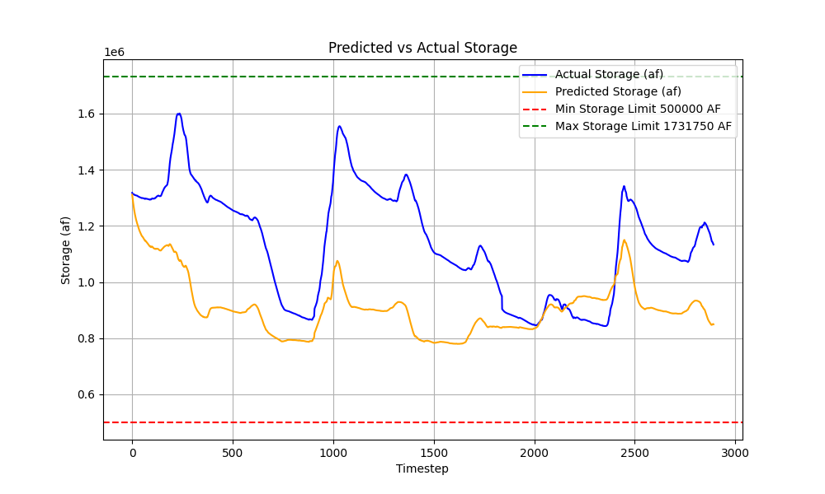
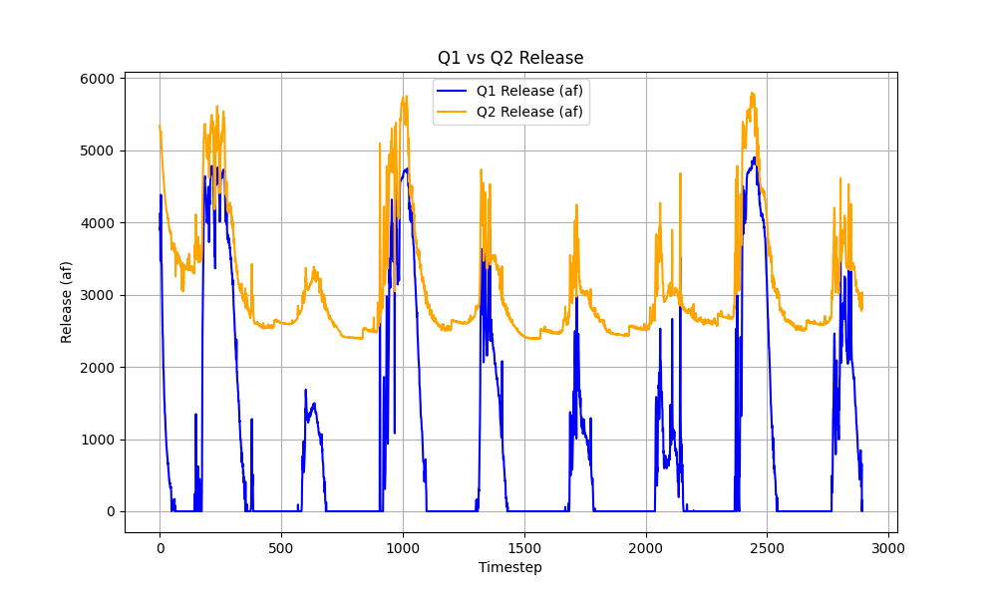
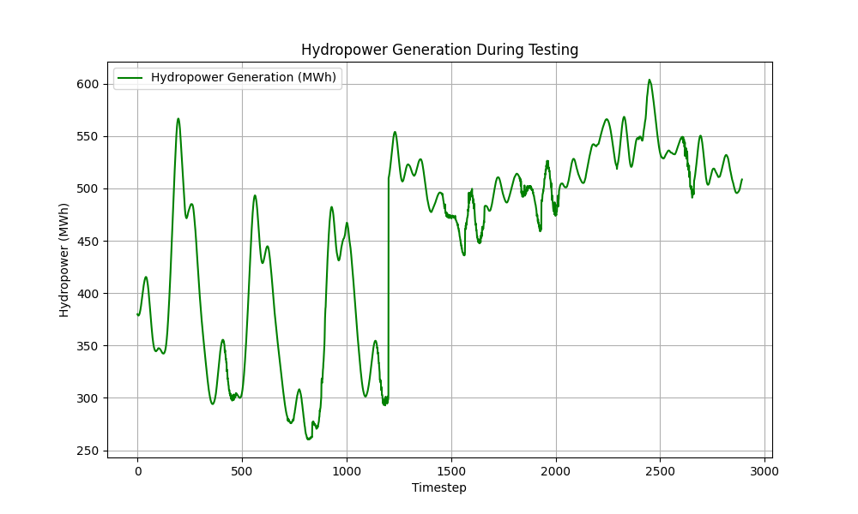
PPO Testing : Test Data Size- 3000 approx.

Slide 22
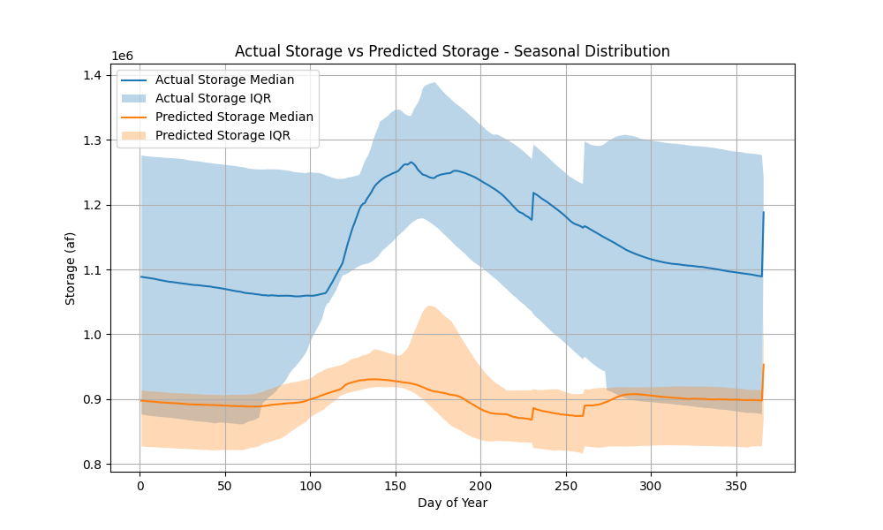
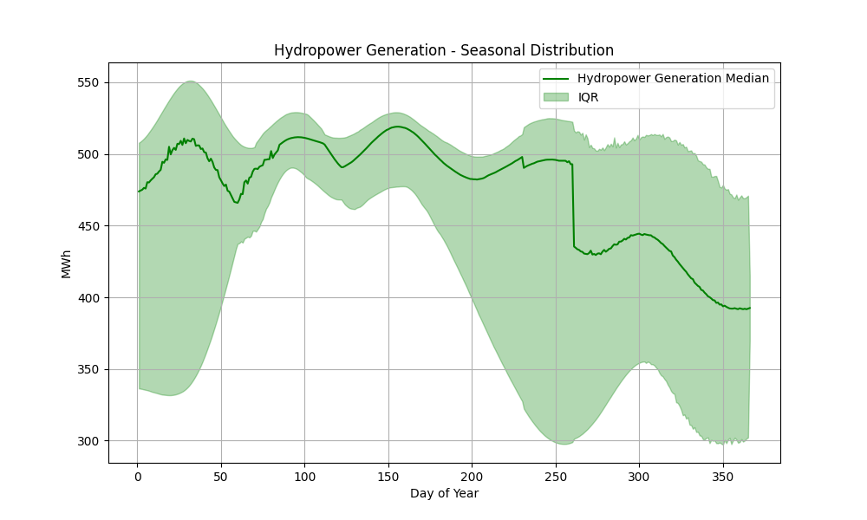
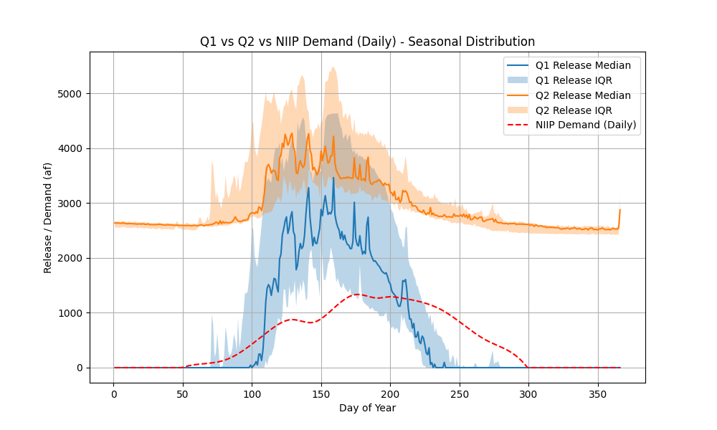
PPO Testing : Test Data Size- 3000 approx.

Slide 23
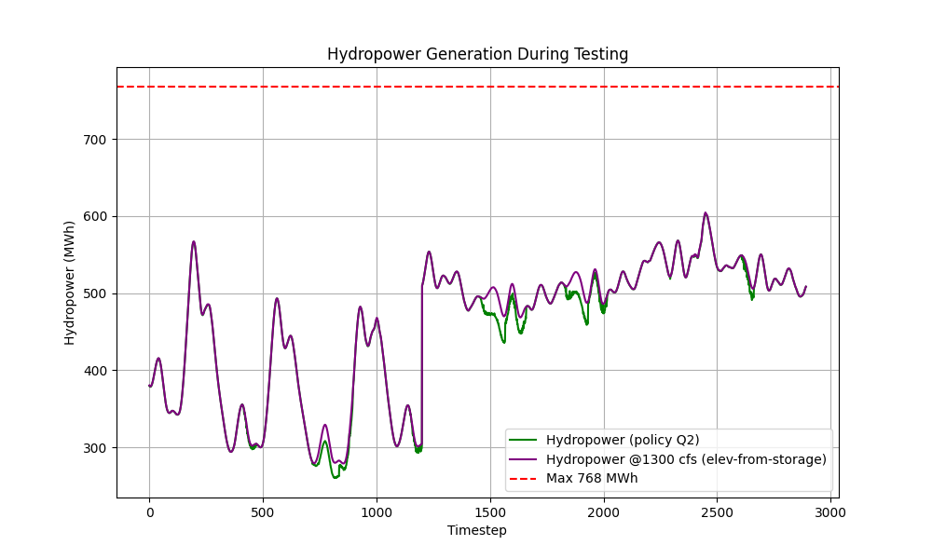
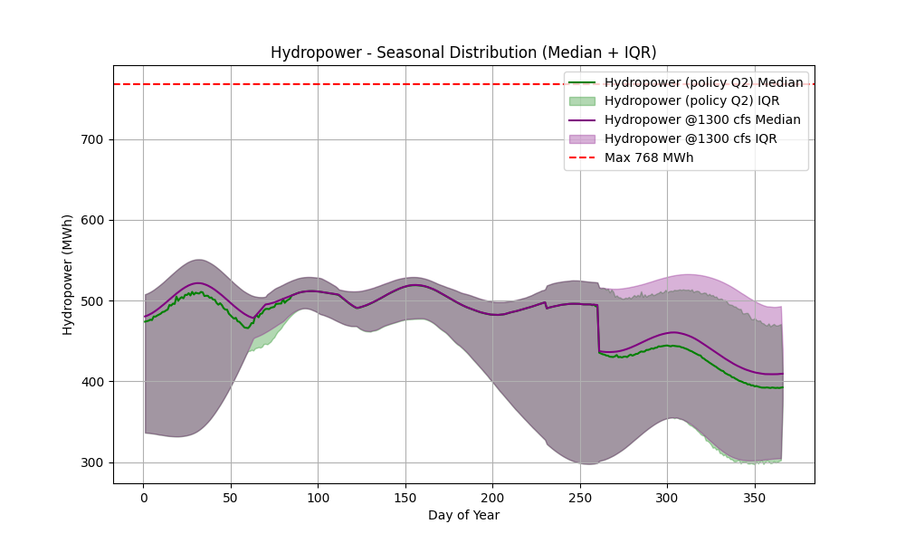
PPO Testing : Test Data Size- 3000 approx.

Slide 24
PPO Testing : Test Data Size- 3000 approx.
Year | Days_with_Demand | Fulfilled_Days | Fulfillment_% | Total_Demand_Volume | Total_Release_Volume | Volume_Fulfillment_%
2016 | 39 | 39 | 100 | 13911.05519 | 76105.75857 | 547.0883233
2017 | 250 | 168 | 67.2 | 184723.7108 | 614465.1685 | 332.6401175
2018 | 250 | 49 | 19.6 | 184723.7108 | 106356.6755 | 57.5760822
2019 | 250 | 167 | 66.8 | 184723.7108 | 549217.3853 | 297.3182939
2020 | 250 | 87 | 34.8 | 184723.7108 | 226696.022 | 122.7216696
2021 | 250 | 40 | 16 | 184723.7108 | 116434.3606 | 63.03162715
2022 | 250 | 35 | 14 | 184723.7108 | 118429.7226 | 64.1118144
2023 | 250 | 148 | 59.2 | 184723.7108 | 537042.9087 | 290.7276529
2024 | 181 | 95 | 52.48618785 | 143613.4272 | 221391.543 | 154.1579693

